Slide 1
Capstone Project
Financial Risk Analysis
Nikita Bhagat
Chayanika Maiti
Rohit Tiwari
(DSC-42 Batch)

Slide 2
Problem Statement :
A portfolio manager makes investment decisions and carries out other related activities on behalf of vested investors. They work with a team of analysts and researchers, and their main objective is to realize the needs of the investor and suggest a suitable portfolio that meets all the expectations.
They are responsible for establishing the best investment strategy, selecting appropriate investments along with the right allocation. However, in doing so, they face a lot of competition in the form of other portfolio managers and rival firms. Therefore, the portfolio manager has to use the available resources to provide the best solution to the investor.
Consider ourselves working for an associate at an investment firm that manages accounts for private clients. Our role requires you to analyse a portfolio of stocks to provide consultation on investment management based on client’s requirement.

Slide 3
Business Goal :
Goal of the Case Study is :
To Suggest a Portfolio of stocks to Mr. Patrick Jyenger based on his risk profile to meet his goal on doubling the amount of 500K Dollars in five years of timespan to buy a minority stake in Naturo.
To Suggest a High risk stocks to Mr. Peter Jyenger based on his risk profile to meet his goal on gaining higher returns for the invested amount of 1 Million Dollars over a five years of timespan to use it for the expansion of JWW.

Slide 4
Data Visualization:
We have cleaned the data and used the formatted data as input to the visualization.
On comparing the actual stocks on the basis of their actual value we noted that stock price of Amazon and Google is extremely high as compared to the stock price of other companies.(as shown in the dashboard in the next slide).
We also tried to analyse the stock sector wise for example Pharma and healthcare sectors , technology sector etc. (shown in further slides).

Slide 5
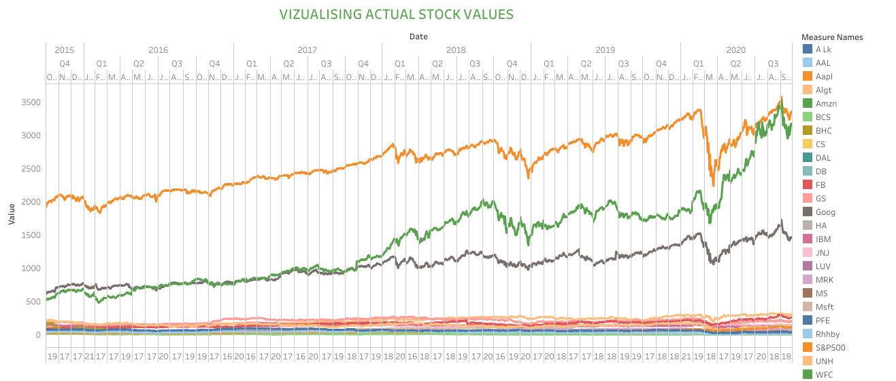

Slide 6
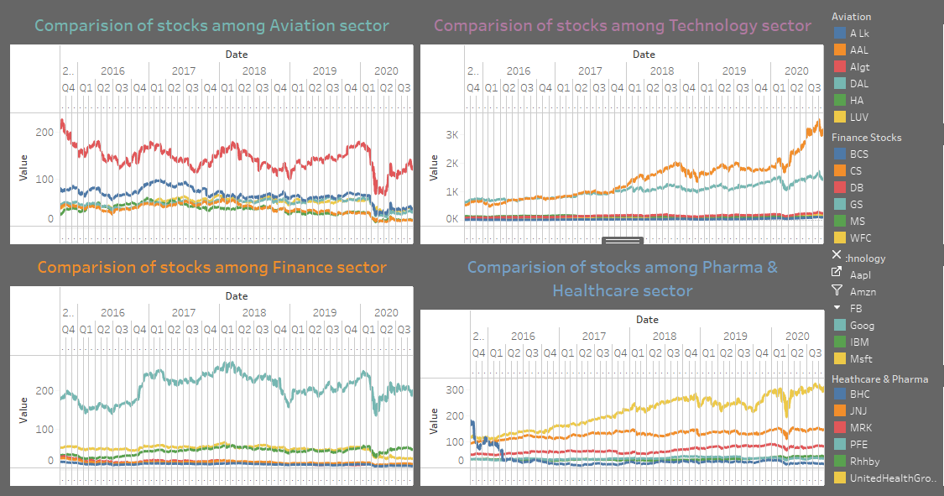
Comparing the stocks of various sectors:

Slide 7
Observations from the graph
Microsoft & Google stocks are highly correlated in the Technology Stocks
Goldman Sachs, Morgan Stanley & Wells Fargo are correlated in the Finance Stocks
American Airlines & Delta Airlines are more correlated than Alaska Air Group in the Aviation stocks
Pharma stocks are less correlated when compared to any other sector stocks

Slide 8
Insights:
At the end of 5 years we can see that the top 8 stocks having returns of greater than 80% are as follows
AMZN gives 40.59% annual returns
MSFT gives 34.95% annual returns
AAPL gives 33.32% annual returns
FB gives 26.45% annual returns
UNH gives 23.72% annual returns
GOOG gives 21.02% annual returns
MS gives 14.55% annual returns
S & P500 gives 13.04% annual returns

Slide 9
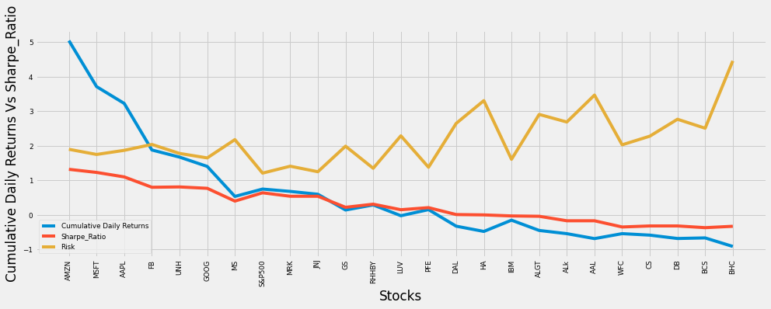
Cumulative Daily Return V/S Sharpe Ratio

Slide 10
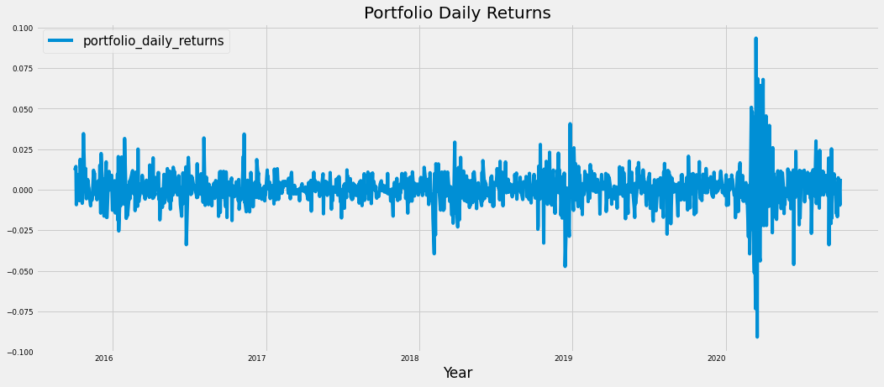
Portfolio Analysis : Patrick Jyengar’s Portfolio
Mr. Patrick Jyengar Portfolio Building
Mr. Patrick Jyengar wants to double his investment in the span on 5 years. He wants to invest in low risk stocks which would fetch him decent returns.
As per his profile Low risk stocks like JNJ,RHHBY and MRK is suitable to invest on. But overall returns with these three stocks wouldn't reach the target what Mr. Patrick is investing for. So one portion of his wealth can be invested on MSFT to gain the desired returns.
As seen in the plot, the portfolio shows larger variation in prices from 2018 to 2019.

Slide 11
Portfolio Risk – Portfolio Standard Deviation
For the portfolio standard deviation formula, we need three elements:
Portfolio weight array
Portfolio covariance matrix
Transpose of portfolio weight array
The weight for each stock in the portfolio is already available. We need to calculate the daily covariance. Remember, the covariance must be annualised by multiplying with 252 (the trading days in a year).
Mr. Patrick Jyengar invests 500 Thousand Dollar on equities i.e. the above Portfolio. Returns that he would fetch after 5 years is 1.58 Million Dollar with 558.23 Thousand dollar of gain.

Slide 12
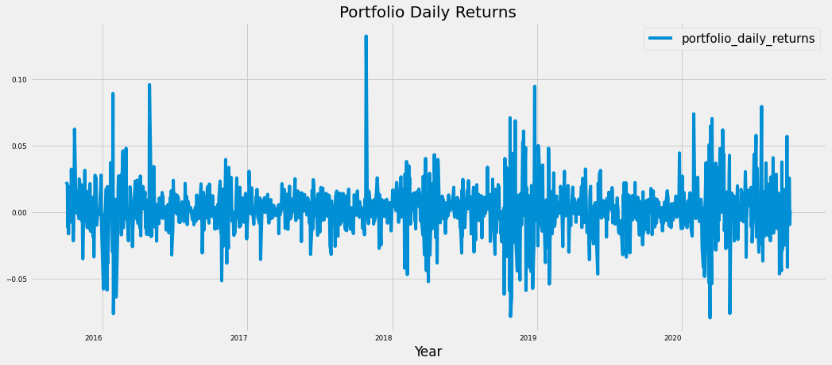
Peter Jyengar Portfolio: Mr. Peter Jyengar Portfolio Building
Mr. Peter Jyengar on the other hand Consistent with his attitude towards risk, he prefers high-return investments. Believes that he can still bounce back in case of any occasional losses. He Wants to invest $1 million from company's cash and cash equivalents in the most high-margin stacks Expects high returns within 5 years for inorganic expansion of his company. As per his profile High risk/High Returns stocks like AMZN and MSFT is suitable to invest on. Overall returns with these stocks would fetch him Maximum returns and also cater the Risks associated with the above mentioned portfolio.
As seen in the plot, the portfolio shows larger variation in prices from end of 2017 to 2020.
Mr. Peter Jyengar invests 1 Million Dollar on equities i.e the above Portfolio. Returns that he would fetch after 5 years is more than 6 Million Dollars with 5+ Million dollars of gain.

Slide 13
Executive Summary & Recommendation to Client:
We have explored stock prices of tech stocks, pharma stocks, Aviation stocks, finance stocks & market Index also. We have looked at the historical price of stock price. We have looked at the volume of stock traded.
We have looked at the daily Return of stock. We have done correlation between the stock prices. Microsoft and Amazon have highest daily price correlation. Maximum daily fluctuation in this stock is 8 % .In stock exchange there is a limit on per day fluctuation of stock. So if the stock reaches the threshold value then the trading of the stock is stopped for that day.
We can see that Amazon Stock has high risk and high returns. Hence, for high returns we have advised Mr. Peter to invest in Amazon.
Stock with Low risk and high return are the best stock to buy. Also, it is best to have stocks from different sectors to have diversified portfolio.
Hence, for low risk and good return we have advised Mr. Patrick to invest one portion in Microsoft and another portion divided equally among Johnson & Johnson, Merck and CO inc. & Roche Holding AG

Slide 14
Thank You

